Slide 1

VIRTUAL INTELLIGENCE DIRECTORATE
x
OMNIA VINCIT SAPIENTA
Generic Ground Force structure
INTREP VID-B-001
NOTE: Virtual Intelligence Directorate (VID) is a fictive intelligence organization created to increase immersion in missions and campaigns hosted and organized by the 132nd Virtual Wing, using DCS (Digital Combat Simulator).
Version: 2.0
Published: 2021-11-06
Notes:
Verson 0.1: Draft 1

Slide 2
Introduction
This report is part of the basic intelligence for 132nd hosted events.
The aim of this report is help pilots understand the organization and structure of enemy ground forces.
The structure in this document is generic and the actual structure in an operation is given as intelligence for that specific operation.
NOTE: This document and structure is a simplification and a compromise between real world organization and DCS limitation, while respecting that this is a hobby and not anyones job.

Slide 3
Version control
Version number | Date | Information changed
0.4 (DRAFT) | 2020-04-25 | Finished Air Defense Forces (ADF)
0.5 (DRAFT) | 2020-05-06 | Corrected errors after feedback
1.0 | 2020-05-07 | Official release
1.1 |  | Corrected picture of BMP 2 and 3.
2.0 | 2021-11-16 | Changed author from VIS to VID
Back to content
Back to Corps

Slide 4
Content
Part 1: Explanation
Explanation
Part 2: Ground Forces
Corps
Armor Division
Mechanized Division
Motorized Division
Air Defense Division
SSM Missile Regiment
Rocket Artillery Regiment
Airborne Brigade
Logistic Regiment
Helicopter Regiment
Reconnaissance Regiment
Part 3: Air Defense Forces
Air Defense Force Region
SA-2 Regiment
SA-5 Regiment
SA-6 Regiment
SA-10 Regiment
SA-2 BN
SA-3 BN
SA-5 BN
SA-6 BN
SA-10 BN
SA-11 BN
Air Defense Force Battalion
Back to content
Back to Corps
4

Slide 5
Explanation: Symbols
PART 1:Explanation
IV Corps
Rank of commanding officer (generals)
Name of unit
Armor Platoon
3x MBT
Types of vehicles in unit
Artillery Battery
Long dashed line indicates that this unit is supporting (attached), and is not organic to the unit. The unit is attached when the force is in the field for combat
Artillery Battalion
Short dashed line indicate that this unit may be split up and detached and will support a unit at a lower echelon , and is not organic to this unit. A unit may be split up and detached to subunits when the force goes to the field for combat
Armor Platoon
Armor Platoon
Armor Platoon
3x MBT
3x MBT
Indicates similar units
(In this example 3 Armor Platoons)
3x MBT
Maneuver units:
Armor, Mechanized and Motorized forces.
Brigade
Brigade is the normal fighting unit (contains air Defense, manueuver units, logistics and artillery).
Division:
Offensive or defensive, this is the normal unit size for a sector.
Corps:
Contains multiple division and additional Corps resources and a headquarter.
Back to content
Back to Corps

Slide 6
Explanation #2
PART 1:Explanation
Ground Forces
Ground forces are the military combat forces. This includes air defense forces assigned to the ground forces.
The main fighting force (the force that engages in battle to defeat the enemys ground forces) are called maneuver forces. Maneuver forces are divided into:
Motorized: Wheeled Infantry (APC)
Mechanized: Tracked Infantry Fighting Vehicles (IFV)
Armor: Main Battle Tanks (MBT)
The maneuver forces are supported by :
- Combat Support (CS) forces: Artillery, Air Defenses, Recon
Combat Service and Support (CSS) forces: Logistics
Air Defense Forces
Air Defense forces are Air Defenses controlled by the Air Force.
Air Defense Forces are divided in two parts:
- Air Defense Force (ADF): Protecting areas, important targets, controlled by Air Force. These forces are a combination of static sites and mobile sites, all of them are connected in a Integrated Air Defense System (IADS)
Air Defense (AD): Protecting maneuver forces, fielded forces, controlled by Army once deployed into the field. These forces are highly maneuverable, but rarely connected to the enemey’s IADS.
Air Defense Regiment (AD Regiment): Supporting the Army
Air Defense Force Regiment (ADF Regiment): Supporting the Air Force
Back to content
Back to Corps

Slide 7
Unit size
PART 1:Explanation
Platoon
3x Fighting vehicles ( MBT, IFV, APC)
Company/ Battery
3x Platoons
Battalion
2-5 Companies (3 line companies + support/HQ)
Brigade / Regiment
3-5 Battalions (3 line Battalions + support/HQ)
Division
3 Line Brigades + Regiments/Battalions for support
Corps
3 Line Divisions + Brigades, Regiments and Battalions in support
NOTE: ”line” refer to maneuver forces such as armor, mechanized or motorized infantry.
Brigade and Regiment are used on the same unit size. Brigade are normally used for manuver forces, and Regiment are used for CS or CSS forces.
Company and battery are similar organizational size. Battery are used for artillery units and air Defense units. Company for any other units.
Back to content
Back to Corps

Slide 8







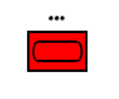

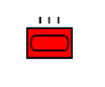

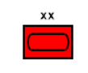

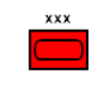
Symbols (Type and size)
PART 1:Explanation
UNIT TYPES
(Combatflite + briefings)
Infantry
Motorized infantry: Wheeled Armored Personell Carriers (APC)
Armor: Main Battle Tanks
Mechanized Infantry: Tracked Infantry Fighting Vehicles (IFV)
Artillery: Mortars
Mechanized Artillery: Tracked artillery
Reconnaissance: Various reconnaissance units
UNIT SIZES
(Combatflite + briefings)
Platoon
Brigade
Regiment
Company/Battery
Division
Battalion
Corps
Back to content
Back to Corps

Slide 9
Explanation : Example
PART 1:Explanation
FLOT
Armor Battalion
Armor Battalion
Armor Brigade
Armor Battalion
Armor Battalion
Armor Battalion
Armor Brigade
Armor Division
Armor Battalion
Armor Battalion
Armor Battalion
Armor Brigade
Armor Battalion
Armor Division Area of Operations
Corps
Mechanized Battalion
Mechanized Division Area of Operations
Mechanized Battalion
Mechanized Brigade
Mechanized Battalion
Mechanized Battalion
Mechanized Battalion
Mechanized Brigade
Mechanized Division
Back to content
Back to Corps

Slide 10
Same example, with military symbols
PART 1:Explanation
FLOT
Back to content
Back to Corps

Slide 11
Explanation : Hierarchy
PART 1:Explanation
CORPS
Helicopter Regiment
Logistics Regiment
Recon Regiment
Air Defense Division
Airborne Brigade
Rocket Artillery Regiment
Motorized Division
Armor Division
Mechanized Division
Surface to Surface Missile Regiment
Air Defense Regiment
Armor Brigade
Logistic Battalion
Rocket Artillery BN
Armor Brigade
Armor Brigade
Air Defense BN
Armor Battalion
Artillery BN
Armor Battalion
Armor BN
This example focuses on a armor division, which is composed of multiple armor brigades, which in turn consist of multiple armor battalions each.
As the example show, the armor division also consist of a air defense regiment, a logistic battalion and a rocket artillery battalion in addition to the armor brigades. Further down at the brigade level the armor brigade have a air Defense battalion and a artillery battalion in addition to the three armor battalion
BN=Battalion
Back to content
Back to Corps

Slide 12
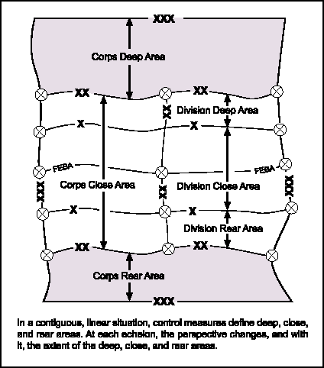
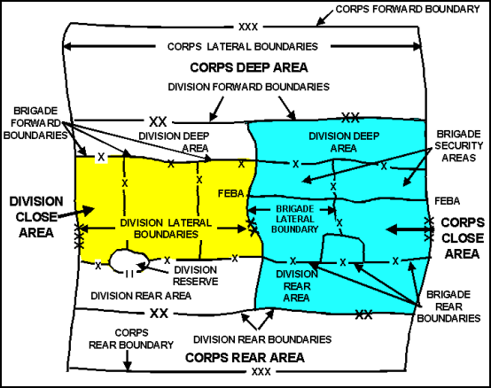
Explanation: Distances
PART 1:Explanation
Deep area
Close area
Rear area
FLOT
Doctrinal distance from FLOT
Airborne Brigade
Maneuver Battalion
Maneuver Brigade
Maneuver Division
CORPS
300-0km
0-10km
10-25km
20-50km
40-200km
FLOT
Explanation:
The Forward Line of Own Troops (FLOT) is the battle line between enemy and friendly forces. The maneuver battalions engaged in combat operations are normally in tactical dispositions from 0 to 10 km from the FLOT. The maneuver brigade and brigade resources is normally placed 10-25 km from the FLOT. Further back in the rear area one can find the manuver divison and the divison resources.
Even further back in the rear area, one will find the Corps and the Corps resources.
Deep area: Behind enemy lines
Close area: Combat zone
Rear area: Within friendly lines
NOTE: Airborne Brigade jumping/parachuting in behind enemy lines
Back to content
Back to Corps

Slide 13
Indicators
PART 1:Explanation
Here are indicators that can be used to identify activity that the enemy is doing:
BM-21 launch or movement into firing positions.
Preparing offensive / Attack
RW activity deep into enemy territory
Insertion of Long Range Recon
FW (transport) activity deep into enemy territory
Airborne Assault ( Many FW transports)
Long range Recon ( If only a single AC is in use, or flying tactical, low level)
Artillery at a certain point (point target)
Trying to kill the target
Artillery at an area
Suppression, to cover for movement / attack
Fill out many more…..
Artillery units in firing position (spread out, IAW a template)
General convoy movement
Upcoming action (offensive), in a certian amount of time
Back to content
Back to Corps

Slide 14
GROUND FORCES
PART 2:Ground Forces
This section includes information about combat maneuver forces
This section contains generic information about unit sizes and organization
Back to content
Back to Corps

Slide 15
Corps
PART 2:Ground Forces
Corps
Armored Division
Motorized Division
Mechanized Division
Air Defense Division
Surface-Surface Missile Regiment
Rocket Artillery Regiment
Helicopter Regiment
Airborne Brigade
Reconnaissance Regiment
Logistic Regiment
NOTE: Click on symbol for link
Back to content
Back to Corps

Slide 16
Headquarters
PART 2:Ground Forces
The following section contains information about the various headquarters. There are 2 variants of each headquarter level (echelon):
Base headquarter
Static headquarter at own territory (homebases). Typically C2 Bunkers or other fixed structures. Each headquarter / base will have a seperate layout and given as a specific briefing or report. During force buildup the forces are assigned to their homebases and training areas.
Field headquarter
Mobile headquarters that can move with the force as the ground forces maneuver in combat, consist of vehicles and tents.
Back to content
Back to Corps

Slide 17
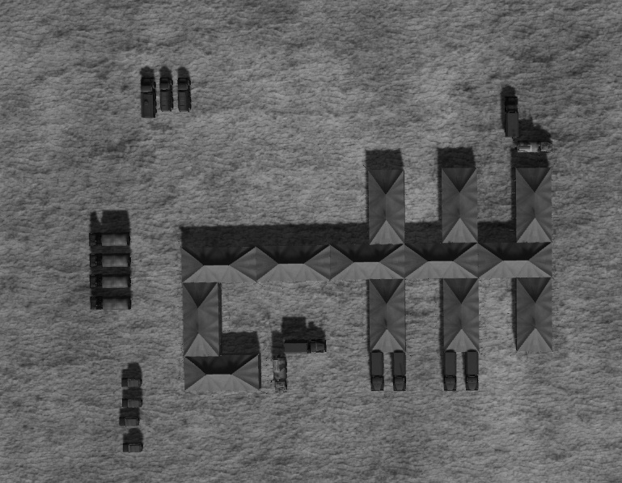
Field Corps HQ
PART 2:Ground Forces
Fuel for generators
Generator vehicles
CP SKP 11 ATC Mobile Command Post
CP Ural 375 PBU
Supply trucks
13 tents
VIP Transport
CP SKP 11 ATC Mobile Command Post
CP Ural 375 PBU
Corps Headquarters (HQ) are located in the rear area and are normally protected by an SA-6 Battalion.
All Corps HQ will have the same tent layout. The amount of vehicles may vary, but as a minimum will include the vehicles in the picture
Back to content
Back to Corps

Slide 18
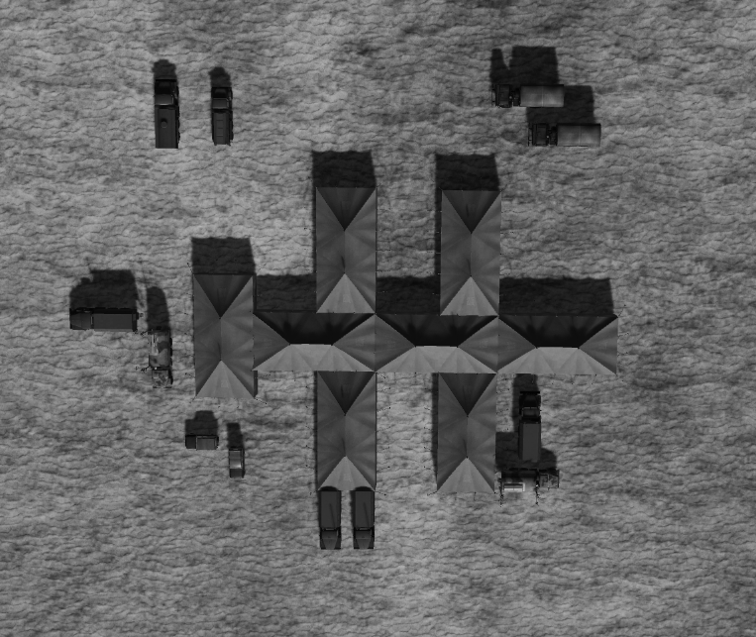
Field Divison HQ
PART 2:Ground Forces
All Division Headquarters will have the same layout on the tents
Back to content
Back to Corps

Slide 19
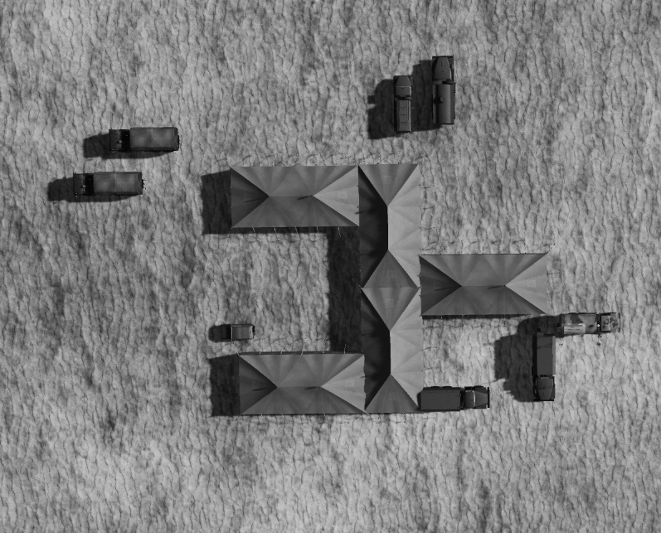
Field Brigade HQ
PART 2:Ground Forces
All Brigade Headquarters will have the same layout on the tents
Back to content
Back to Corps

Slide 20
Armor Division
PART 2:Ground Forces
Armor Division
Armor Brigade
Logistics Battalion
Armor Brigade
Armor Brigade
Rocket Artillery Battalion
Air Defense Regiment
Armor Division
3xMBT Brigades:
243x MBT + 27x fueltrucks + 27x ammo trucks
54x Arty + 27x ammo trucks
Air Defense Regiment:
36x ZSU-23/4 (or SA19) + 36x SA-19
4x SA-8 + 4x SA-15 + 1x CP Sborka
8xTransport GAZ-66
Logistical BN:
6x Fueltrucks + 6x Supply trucks + 6x Ammo trucks
Rocket Arty BN:
4x BM-21 GRAD
2x Transport URAL-4320T
3x CP URAL-375 PBU
Back to content
Back to Corps

Slide 21
Armor Brigade
PART 2:Ground Forces
Armor Brigade
From Air Defense Regiment at Division Level
Armor BN
Artillery BN
Air Defense BN
Armor BN
Armor BN
Armor Brigade:
3xMBT BN :
81x MBT+9x fueltrucks+9x ammo trucks
Artillery BN:
18x Arty + 9x ammo trucks
Air Defense BN:
12x ZSU-23/4 (or SA-19)
12x SA-19
6x Transport GAZ-66
Back to content
Back to Corps

Slide 22
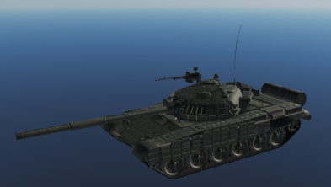
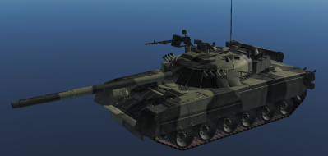
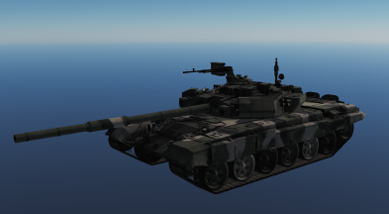
PART 2:Ground Forces
Armor Battalion
Armor BN
From Arty BN at Armor Brigade level
Armor Company
Logistics Company
Artillery Battery
Armor Company
Armor Company
Air Defense Battery
Armor Platoon
Fuel Platoon
Armor Platoon
From Air Defense Brigade at Armor Brigade level
Armor Platoon
3x MBT
3x Fuel trucks
3x MBT
3x MBT
Armor Battalion:
3xMBTCompany:
9x MBT+3x fueltrucks
+3x ammo trucks
Artillery Battery:
6x Arty + 3x ammo trucks
Air Defense Battery:
4x ZSU-23/4 (or SA-19)
4x SA-19
2x Transport GAZ-66
Ammo Platoon
3x Supply trucks
T72
T80U
T90
Back to content
Back to Corps

Slide 23
Mechanized Division
PART 2:Ground Forces
Mechanized Div
Mechanized Brigade
Logistics Battalion
Mechanized Brigade
Mechanized Brigade
Rocket Artillery BN
Mechanized Division
3xMechanized Brigades:
243x IFV + 27x fueltrucks + 27x ammo trucks
54x Arty + 27x ammo trucks
Air Defense Regiment:
36x ZSU-23/4 (or SA-13) + 36x SA-13
4x SA-8 + 4x SA-15 + 1x CP Sborka
8xTransport GAZ-66
Logistical BN:
6x Fueltruck
6x Supply truck
6x Ammo truck
Rocket Arty BN:
4x BM-21 GRAD
2x Transport URAL-4320T
3x CP URAL-375 PBU
Air Defense Regiment
Back to content
Back to Corps

Slide 24
Mechanized Brigade
PART 2:Ground Forces
Mechanized Brigade
From Air Defense Regiment at Division Level
Armor BN
Artillery BN
Air Defense BN
Armor BN
Mechanized BN
Mechanized Brigade:
3xMechanized BN :
81x IFV+9x fueltrucks+9x ammo trucks
Artillery BN:
18x Arty + 9x ammo trucks
Air Defense BN:
12x ZSU-23/4 (or SA-13)
12x SA-13
6x Transport GAZ-66
Back to content
Back to Corps

Slide 25
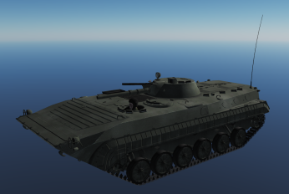
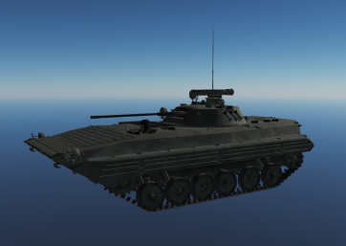
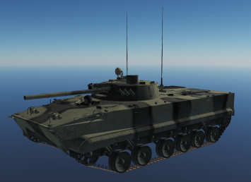
PART 2:Ground Forces
Mechanized BN
Mechanized BN
From Arty BN at Mechanized Brigade level
Armor Company
Logistics Company
Artillery Battery
Armor Company
Mechanized Company
Air Defense Battery
Armor Platoon
Fuel Platoon
Armor Platoon
From Air Defense Brigade at Mechanized Brigade level
Mechanized Platoon
3x MBT
3x Fuel trucks
3x MBT
3x IFV
Ammo Platoon
Mechanized Battalion:
3x Companies :
27x IFV+x3 fueltrucks
+3x ammo trucks
Artillery Battery:
6x Arty + 3x ammo trucks
Air Defense Battery:
4x ZSU-23/4 (or SA-13)
4x SA-13
2x Transport GAZ-66
3x Supply trucks
IFV BMP-1
IFV BMP-2
IFV BMP-3
Back to content
Back to Corps

Slide 26
Motorized Division
PART 2:Ground Forces
Motorized Div
Motorized Brigade
Logistics Battalion
Motorized Brigade
Motorized Brigade
Rocket Artillery BN
Motorized Division
3xMotorized Brigades:
243x APC + 27x fueltrucks + 27x ammo trucks
54x Arty + 27x ammo trucks
Air Defense Regiment:
36x ZSU-23/4 (or SA9) + 36x SA-9
4x SA-8 + 4x SA-15 + 1x CP Sborka
8xTransport GAZ-66
Logistical BN:
6x Fueltruck
6x Supply truck
6x Ammo truck
Rocket Arty BN:
4x BM-21 GRAD
2x Transport URAL-4320T
3x CP URAL-375 PBU
Air Defense Regiment
Back to content
Back to Corps

Slide 27
Motorized Brigade
PART 2:Ground Forces
Motorized Brigade
From Air Defense Regiment at Division Level
Armor BN
Artillery BN
Air Defense BN
Armor BN
Motorized BN
Motorized Brigade:
3xMotorized BN :
81x APC +9x fueltrucks+9x ammo trucks
Artillery BN:
18x Arty + 9x ammo trucks
Air Defense BN:
12x ZSU-23/4 (or SA-9)
12x SA-9
6x Transport GAZ-66
Back to content
Back to Corps

Slide 28
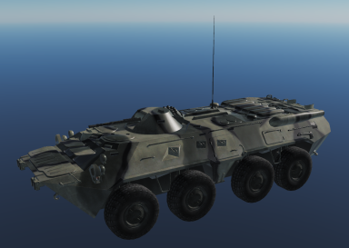
PART 2:Ground Forces
Motorized Battalion
Motorized BN
From Arty BN at Motorized Brigade level
Armor Company
Logistics Company
Artillery Battery
Armor Company
Motorized Company
Air Defense Battery
Armor Platoon
Fuel Platoon
Armor Platoon
From Air Defense Brigade at Motorized Brigade level
Motorized Platoon
3x MBT
3x Fuel trucks
3x MBT
3x APC
Ammo Platoon
Motorized Battalion:
3x Companies :
27x APC+3x fueltrucks
+3x ammo trucks
Artillery Battery:
6x Arty + 3x ammo trucks
Air Defense Battery:
4x ZSU-23/4 (or SA-9)
4x SA-9
2x Transport GAZ-66
3x Supply trucks
BTR-80
Back to content
Back to Corps

Slide 29
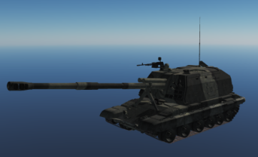
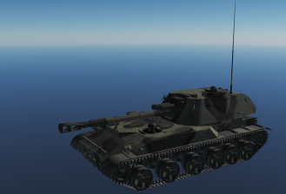
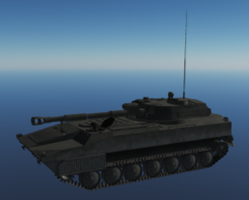
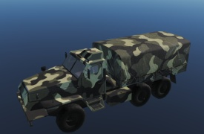
Artillery Battalion
PART 2:Ground Forces
Artillery BN
Artillery Battery
Logistics Company
Artillery Battery
Artillery Battery
Artillery Section
Ammo Platoon
Artillery Section
Ammo Platoon
Ammo Platoon
3x Arty
3x Supply trucks
3x Arty
3x Supply trucks
3x Ammo trucks
SPH 2S19 Msta
SPH 2S3 Akatsia
SPH 2S1 Gvodzika
Back to content
Transport URAL-4320-31 Armored
Back to Corps

Slide 30
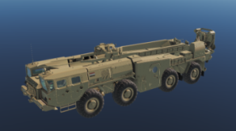
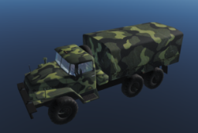
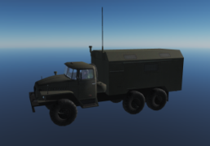
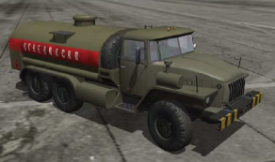
Surface-to-Surface Missile Regiment
PART 2:Ground Forces
SSM Regiment
- The SSM Regiment supports the Corps,
and is a Corps high value target.
- SSM Regiment will support offensive or defensive operations by attacking High Value Targets (logistical sites / headquartes /airfields /FARPs).
- May be assigned to the Main Effort Division (offensive/defensive).
- Will normally be placed in the Corps or Division area, protected by Corps/ Division Air Defense assets.
TOTAL:
8x SCUDs
4x Transport URAL-4320T
6x CP URAL-375 PBU
8x Fuel truck ATZ-10
The regiment consists of:
2x Battalions
Each battalion have 2x Missile batteries and 1x headquarter platoon.
SSM Missile BN
SSM BN
SSM Missile Battery
Headquarter platoon
SSM Battery
SSM Battery:
2x TEL (launcher vehicles) per battery
+ 1x Transport URAL-4320T (Warhead)
+2x Fuel truck (rocket fuel) ATZ-10
Headquarter platoon
3x CP URAL-375 PBU
SCUD B Launcher (TEL)
Transport URAL-4320T
CP URAL-375 PBU
Fuel Truck ATZ-10
Back to content
Back to Corps

Slide 31

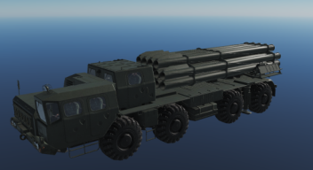
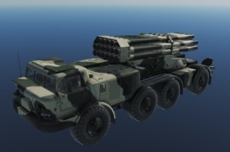
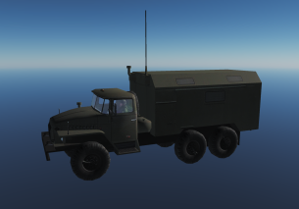
Rocket Artillery Regiment
PART 2:Ground Forces
The Rocket Artillery Regiment supports the Corps, and is a high value target.
TOTAL:
4x SMERCH TEL
4x URAGAN TEL
4x Transport URAL-4320T
6x CP URAL-375 PBU
The regiment consists of:
2x Heavy rocket artillery Battalions
Each battalion have 2x MLRS batteries and 1x headquarter platoon.
Rocket Artillery Regiment
Rocket Artillery BN
Heavy Rocket Artillery BN
Smerch Battery
Uragan Battery
Headquarter platoon
2x SMERCH TEL
1x URAL-4320T
Headquarter platoon
3x CP URAL-375 PBU
2x URAGAN TEL
1x URAL-4320T
Transport URAL-4320T
MLRS 9A52 SMERCH (TEL)
MLRS 9K57 URAGAN BM-27 (TEL)
CP URAL-375 PBU
Back to content
Back to Corps

Slide 32
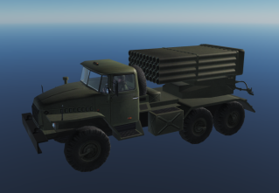
Rocket Artillery BN
PART 2:Ground Forces
Rocket Artillery BN
Rocket Artillery Battery
Headquarter platoon
Rocket Artillery Battery
Headquarter platoon
3x CP URAL-375 PBU
2x BM-21 GRAD
1x URAL-4320T
The Rocket Artillery BN supports a maneuver division, and is a division high value target.
Will normally support an offensive, and will be forward deployed to the brigade in the offense during the offensive or start of the offensive.
Will normally attack assembly areas, high value targets (logisitcs and C2) or BN frontline sized units.
In defensive, it will stay back, protected by Division Air Defense Assets, camoflaged.
TOTAL:
4x BM-21 GRAD
2x Transport URAL-4320T
3x CP URAL-375 PBU
MLRS BM-21 GRAD
CP URAL-375 PBU
Transport URAL-4320T
Back to content
Back to Corps

Slide 33
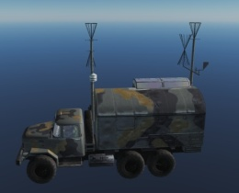
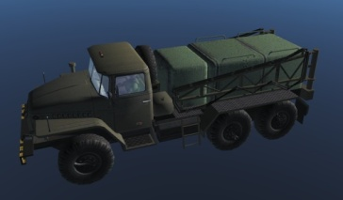
Air Defense Division
PART 2:Ground Forces
Air Defense Division
Air Defense Regiment
SA-6 BN
HQ / C2 Battalion
Air Defense Regiment
Air Defense Regiment
SA-11 BN
Each Air Defense Regiment is attached to the Armored, Motorized and Mechanized Divisions
SA-6 BN and SA-11 BN is used to protect Corps High Value targets (Such as: Headquarter, Logisitcal sites, Missile regiments , Rocket Artillery regiments)
HQ/C2 BN is used to coordinate the effort between all Air Defense Regiments and the independent Battalions.
The HQ/C2 BN makes it possible for the Air Defense Division to use the long range radars in the SA-6 or SA-11 BN to provide targeting data for the Air Defense Regiments.
HQ/C2 BN consist of:
1x CP SKP 11 ATC Mobile Command Post (C2)
1x CP URAL-375 PBU (Communcation Node)
1x GPU APA-5D (Power)
CP SKP-11 ATC Mobile Command Post
CP URAL-375 PBU
GPU APA-5D on URAL-4320
Back to content
Back to Corps

Slide 34
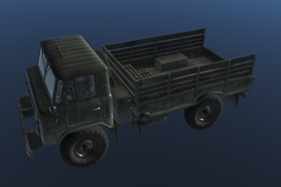
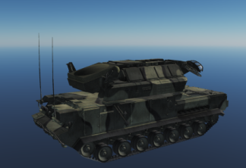
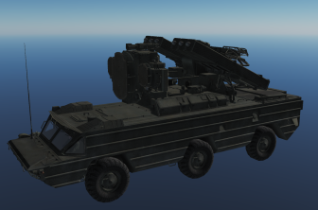
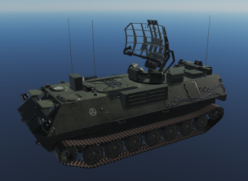
Air Defense Regiment
PART 2:Ground Forces
Air Defense Regiment
Air Defense Battalion
SA-8 BN
SA-15 BN
Air Defense Battalion
Air Defense Battalion
4x Launchers
+ Manpads
+ 4x Transport GAZ-66
4x Launchers
+ CP Sborka
+ Manpads
+ 4x Transport GAZ-66
Each Air Defense Battalion is assigned to a Brigade (Armored, Motorized or Mechanized) within the Division the Air Defense Regiment supports. For accurate type and number of the air defense Battalion in question, see under armored, motorized or mechanized Brigade.
SA-8 BN and SA-15 BN support the Division High Value Targets.
SA-15 BN may also be used for point Defense .
GAZ-66
SA-15
SA-8
CP Sborka
Back to content
Back to Corps

Slide 35
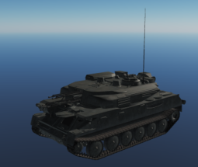
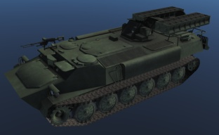
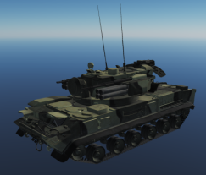
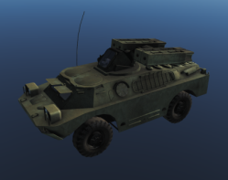
Air Defense Battalion
PART 2:Ground Forces
Air Defense Battalion
Each Air Defense Battery is detached to line battalions (Armored, Motorized or Mechanized battalions).
Air Defense Battery
Air Defense Battery
Air Defense Battery
Air Defense Platoon
Air Defense Platoon
Air Defense Platoon
Air Defense Platoon
Air Defense Platoon
Air Defense Platoon
Air Defense Battalion supports Maneuver Brigade
1x Air Defense Battery supporting a maneuver BN
Air Defense Platoon comes in 6 Different variants depending on the unit they are supporting:
#1: 1x ZSU23/4 + SA-9 (Motorized) + 1x Transport GAZ-66
#2: 1x ZSU23/4 + SA-13 (Mechanized) + 1x Transport GAZ-66
#3: 1x ZSU23/4 +SA-19 (Armor) + 1x Transport GAZ-66
#4: 1x SA-19+ SA-19 (Armor) + 1x Transport GAZ-66
#5: 1x SA-13 + SA-13 (Mechanized) + 1x Transport GAZ-66
#6: 1x SA-9 + SA-9 (Motorized) + 1x Transport GAZ-66
Transport GAZ-66
ZSU 23/4
SA-13
SA-19
SA-9
Back to content
Back to Corps

Slide 36

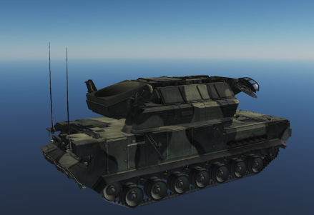




PART 2:Ground Forces
CP 9S80M1 Sborka
SA-15
SA-8
SA-9
SA-13
SA-19
ZSU 23/4
Back to content
Back to Corps

Slide 37
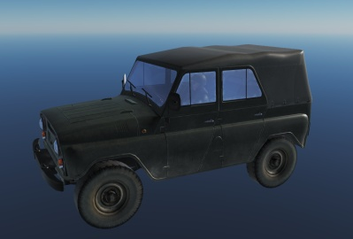
Recon Regiment
PART 2:Ground Forces
Reconnaissance Regiment
Reconissance Battalion
Long Range Recon Battalion
Special Recon Battalion
Reconissance Battalion
Recon Battalion
Total:
3x Recon Battalions:
- 18x wheeled (1 BN)
- 36x tracked (2x BN)
1x Long Range BN:
- Infantry in groups of 4
1x Special Recon BN:
- 18x CP URAL 375 PBU
UAZ-469
CP URAL-375 PBU
1x Recon Battalion per Division, 1x Company per Brigade (used to recon the Brigades main axis of advance)
Long Range Recon:
Long range Recon uses RW, plane (parachute) or infiltrates by foot, deep behind enemy lines.
Primary task to locate high value targets, such as logistics, Artillery and C2 of enemy forces or to prepare LZ for the Airborne Brigade.
Special Recon:
Uses Electronic warfare, both for jamming, direction finding, and collecting intelligence on enemy forces.
NOTE: Recon units due to its nature of collecting intelligence operates close to the FLOT, or on the enemy side of the FLOT.
Back to content
Back to Corps

Slide 38
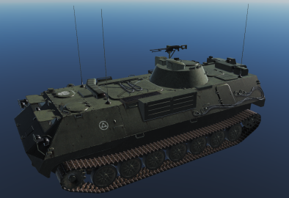
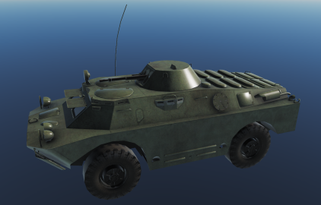
Recon BN
PART 2:Ground Forces
Recon Battalion
Recon
Company
Recon
Company
Recon
Company
Recon
Company
Wheeled
Recon Platoon
Recon Platoon
Recon Platoon
Recon Platoon
Recon Platoon
Recon Platoon
Recon Platoon
Recon Platoon
Recon Platoon
NOTE:
Recon BN is either tracked or wheeled.
Recon BN supporting Armor or Mechanized forces use ARV-MTLB-U.
Recon BN supporting Motorized company use the ARV BRDM-2
In each platoon there are 2 vehicles
Recon units work together in pairs.
Total:
6x Recon Vehicle per company
18x vehicles in the BN
ARV MTLB-U BOMAN
ARV BRDM-2
Back to content
Back to Corps

Slide 39
Special Recon BN
PART 2:Ground Forces
Special Recon Battalion
Company
Company
Company
NOTE: Special Recon BN only operate in company sized in order to use Electronic Warfare (EW) in a proper way.
Each Company has 6x CP URAL 375 PBU (vehicle identified by the antenna used for EW and Command and Control)
The vehicles always operate in pairs. If 2x CP URAL-375 PBU operating together it is likely part of the Special Recon BN.
Special Recon BN can be used in support of combat forces by collecting intelligence, jamming and direction finding.
Companies may also be assigned certain areas in the rear where they are doing force protection, for example by jamming various frequencies.
CP URAL-375 PBU
Back to content
Back to Corps

Slide 40
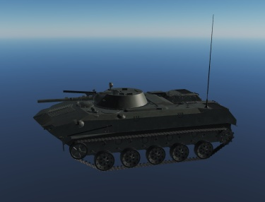
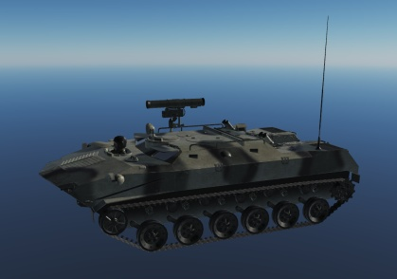
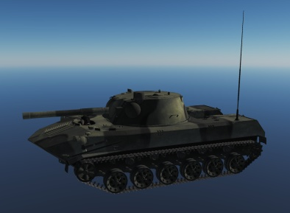
Airborne Brigade
PART 2:Ground Forces
Airborne Brigade
Air Assault BN
Airborne Artillery BN
Air Assault BN
Airborne BN
TOTAL:
81x IFV
27x ARV BTR-RD
18x Arty
= 126 vehicles = 42x IL-76 Sorties to move the Airborne Brigade
Inserted via IL-76MD
One IL-76 can carry 3x BMD (1x Airborne Platoon)
IFV BMD-1
ARV BTR-RD
SPH 2S9 NONA
Back to content
Back to Corps

Slide 41
Airborne Battalion
PART 2:Ground Forces
Airborne Battalion
Air Assault Company
Airborne Anti-tank Company
Airborne Artillery Company
Air Assault Company
Airborne Company
IFV BMD-1
ARV BTR-RD
SPH 2S9 NONA
IFV BMD-1
9x vehicles
6x vehicles
IFV BMD-1
27x vehicles
42 vehicles total = 14x IL-76 to move one Airborne BN
Inserted via IL-76MD
One IL-76 can carry 3x BMD (1 Airborne Platoon)
IFV BMD-1
ARV BTR-RD
SPH 2S9 NONA
Back to content
Back to Corps

Slide 42
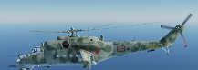
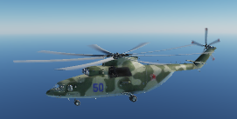
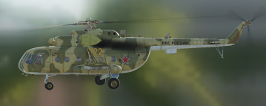
Helicopter Regiment
PART 2:Ground Forces
Helicopter Regiment
Attack Helicopter Squadron
Transport Helicopter Squadron
Transport Helicopter Squadron
Attack Helicopter Squadron (AHS).
Consist of 6x MI-24.
Attack Helicopter Squadrons are used for CAS mission in support of combat forces, and Armed Reconnissance further behind the enemy FLOT.
Transport Helicopter Squadron (THS).
Consist of 6x MI-26 or MI-8.
Transport Helicopter Squadrons are used for transport of supplies, medevacs, air assaults, insertion of long range recon forces.
MI-24
MI-26
MI-8
Back to content
Back to Corps

Slide 43
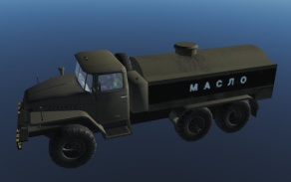
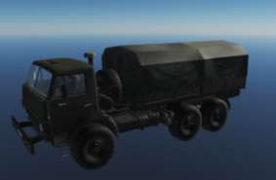



Logistic Regiment
PART 2:Ground Forces
Logistic Regiment
FARP BN
Logistical BN
Medical BN
Logistical BN
Logistic BN
2x FARPs
Per FARP:
1x CP SKP-11 ATC Mobile Command Post (C2)
Transport URAL 375 (ammo)
GPU APA-80 on ZiL-131
Fuel Truck ATMZ-5
Large supply point in the rear. Transfer to frontline Divisions.
- Ammo
- Fuel
- Food
Fuel Truck ATMZ-5
Transport KAMAZ 43101
Transport URAL-375
CP SKP-11 ATC Mobile Command Post
Specific vehicles: (same throughout all echelons)
Ammo: URAL-375
Fuel: Fuel Truck ATMZ-5
Food: KAMAZ 43101
GPU APA-80 on ZiL-131
Back to content
Back to Corps

Slide 44


Logistic Battalion
PART 2:Ground Forces
Logistic BN
Fuel Company
Supply Company
Ammo Company
Fuel Platoon
Supply Platoon
Ammo Platoon
3x Fuel trucks
3x Supply trucks
3xSupply trucks
Fuel Platoon
Supply Platoon
Ammo Platoon
3x Fuel trucks
3x Supply trucks
3x Supply trucks
Fuel Truck ATMZ-5
Transport KAMAZ 43101
Transport URAL-375
Back to content
Back to Corps

Slide 45


Medical Battalion
PART 2:Ground Forces
NOTE:
Field hospitals and ambulances are in the NO STRIKE LIST, and are not to be attacked.
Medical BN
Evacuation Company
Field Hospital Company
Field hospital consist of 4x tents, with the shape shown below.
Evacuation Platoon
Evacuation Platoon
3x Field Ambulances
3x Field Ambulances
APC TIGR 233036
Back to content
Back to Corps

Slide 46








PART 2:Ground Forces
Fuel Truck ATMZ-5
Fuel Truck ATZ-10
GPU APA-80 on ZiL-131
GPU APA-5D on URAL-4320
CP SKP-11 ATC Mobile Command Post
Transport GAZ-66
Transport KAMAZ 43101
Transport UAZ-469
Back to content
Back to Corps

Slide 47



PART 2:Ground Forces
Transport URAL-375
Transport URAL-4320-31 Armored
Transport URAL-4320T
Back to content
Back to Corps

Slide 48
SPECIAL UNITS
PART 2:Ground Forces
The following section will cover special units/formations that can be encountered on the battlefield.
Back to content
Back to Corps

Slide 49

VIP General Escort
PART 2:Ground Forces
When generals are moving around on the battlefield, they are transported in UAZ-469 vehicles in convoys.
For a 3-star general, the convoy will consist of 2x BTR-80 (one at the front, and one in the rear), one ZSU 23/4, and 6x UAZ-469 veichles.
For a 2-star general, the convoy will consist of 2x BTR-80 (front and rear guard), 1x ZSU 23/4 and 4x UAZ-469
For a 1-star general, the convoy will consist of 2 x BTR-80 (front and rear guard), 1x ZSU 23/4 and 2x UAZ-469.
Generals typically move back and forth between the various HQ’s in order to coordinate or recive mission/tasks. Or visits troops to boost morale.
UAZ-469
Back to content
Back to Corps

Slide 50
Air Defense Forces (ADF)
PART 3: Air Defense Forces
This section includes information about the Air Defense Forces protecting critical installations.
Controlled by the Air Force.
Back to content
Back to Corps

Slide 51


Air Defense Force Region
PART 3: Air Defense Forces
ADF
Region
Air Defense Force’s are organized in regions. Each region is controlled from a centralized Command and Control (C2) centre, located in bunkers. In order to function properly the C2 centre need power. If it is cut from its power supply it will be unable to conduct its function, and the IADS network in the region will not function.
Powersupply
C2 Centre
Back to content
Back to Corps

Slide 52
SA-2 Regiment
PART 3: Air Defense Forces
SA-2
Regiment
Early Warning Radar
SA-2 BN
SA-3 BN
Air Defense Force Battery
SA-3 BN
The SA-2 Regiment is used to provide area Defense in important areas. The regiment have a Early Warning Radar. The EWR is tied into the region’s IADS and provides information to the rest of the IADS. It also contains an SA-2 BN that provides coverage in medium and high altitudes. It also has 2 SA-3 BN’s for low and medium altitude coverage in anticipated avenues of approach where low-level flying would make it possible for aircraft to close in on the SA-2. In addition the regiment also has a ADF battery to provide close protection of the SA-2 or SA-3 BN’s.
Back to content
Back to Corps

Slide 53
SA-5 Regiment
PART 3: Air Defense Forces
SA-2
Regiment
Early Warning Radar
SA-5 BN
SA-3 BN
Air Defense Force Battery
SA-3 BN
The SA-5 Regiment is used to provide area Defense in important areas. The regiment have a Early Warning Radar. The EWR is tied into the region’s IADS and provides information to the rest of the IADS. It also contains an SA-5 BN that provides coverage in medium and high altitudes. It also has 2 SA-3 BN’s for low and medium altitude coverage in anticipated avenues of approach where low-level flying would make it possible for aircraft to close in on the SA-5. In addition the regiment also has a ADF battery to provide close protection of the SA-5 or SA-3 BN’s.
Back to content
Back to Corps

Slide 54
SA-6 Regiment
PART 3: Air Defense Forces
SA-6 Regiment
Early Warning Radar
SA-6 BN
SA-6 BN
Air Defense Force Battery
The SA-6 Regiment is used to protect important areas. The SA-6 Regiment is highly maneuverable and will use its connection with the IADS to the maximum extent possible by keeping the SAM sites dark and only going active once enemy aircraft are within range. The SA-6 regiment consists of 1 EWR site that is connected to the region IADS. There are 2 SA-6 BNs and a ADF battery providing close protection to the SA-6 BNs.
Back to content
Back to Corps

Slide 55
SA-10 Regiment
PART 3: Air Defense Forces
SA-10 Regiment
Early Warning Radar
SA-10 BN
SA-11 BN
Air Defense Force Battery
The SA-10 Regiment is used to protect critical and high value targets, such as airfields. The various SAM battalions are maneuverable and will shift positions regularly to avoid enemy detection. The Regiment will use its connection to the IADS and stay dark as much as possible. It will only og active if enemy aircraft are within range. The SA-10 regiment consist of an EWR that is tied into the region’s IADS. The main unit is the SA-10 BN that is a high treat to all aircraft operating in its vicinity. An ADF Battery provide close protection.
Back to content
Back to Corps

Slide 56







SA-10 Battalion
PART 3: Air Defense Forces
”GRUMBLE”
SA-10 Battalion
SA-10 Battalions are the key part of a SA-10 regiment, and protect high value targets such as enemy airfields or other critically important targets.
A SA-10 Battalion consist of:
- 1x S300 SR ”Big Bird” (Search Radar)
- 1x S300 SR ”Clam Shell” (Search Radar)
- 1x S300 TR ”Flap Lid” (Tracking Radar)
- 1x S300 C2 (Command and control and communication node)
- 4x S300 TEL C (Launcher)
- 4x S300 TEL D (Launcher)
- 2x Transport GAZ-66 (Resupply)
S-300 TR Flap Lid
S-300 SR Clam Shell
S-300 SR Big bird
S-300 C2
S-300 TEL C
S-300 TEL D
Transport GAZ-66
Back to content
Back to Corps

Slide 57




SA-2 Battalion
PART 3: Air Defense Forces
”GUIDELINE”
SA-2 Battalion
SA-2 Battalions are static sites that do not move often. SA-2 have a long range and are the key element in a SA-2 regiment. SA-2 Battalions normally protect high value targets and are a area Defense SAM.
A SA-2 Battalion consist of:
1x SA-2 TR ”Fan Song” (Tracking radar)
1x SR ”Flat Face”(Search radar)
6x SA-2 LN (Launcher)
1x CP URAL-375 PBU (Command and control and communication node)
3x Transport GAZ-66 (Resupply)
CP URAL-375 PBU
SA-2 TR Fan Song
SR Flat Face
SA-2 LN SM-90
Transport GAZ-66
Back to content
Back to Corps

Slide 58



SA-3 Battalion
PART 3: Air Defense Forces
”GOA”
SA-3 Battalion
SA-3 Battalions are static sites that do not move often. SA-3 Battalions are normally part of SA-2 regiments guarding low altitude avenues of approach that may be a threat to the SA-2 site.
A SA-3 Battalion consist of:
1x SR ”Flat Face” (Search Radar)
1x S-125 TR ”Low Blow” (Tracking Radar)
4x S-125 LN (Launchers)
1x CP URAL-375 PBU (Command and Control & Communication node)
2x Transport GAZ-66 (Resupply)
CP URAL-375 PBU
SR Flat Face
S-125 Low Blow
S-125 LN 5P73
Transport GAZ-66
Back to content
Back to Corps

Slide 59



SA-5 Battalion
PART 3: Air Defense Forces
”GAMMON”
SA-5 Battalion
SA-5 Battalions are static sites that do not move often. SA-5 have a very long range and are the key element in a SA-5 regiment. SA-5 Battalions normally protect high value targets and are a area Defense SAM.
A SA-5 Battalion consist of:
1x SA-5 SR ”Tin Shield” (Search Radar)
1x SA-5 TR ”Squaire Pair” (Tracking Radar)
6x SA-5 Launcher
1x CP URAL-375 PBU (Command and control and communication node)
3x Transport GAZ-66 (Resupply)
CP URAL-375 PBU
SA-5 SR Tin Shield
SA-5 TR Square Pair
SA-5 LN
Transport GAZ-66
Back to content
Back to Corps

Slide 60


SA-6 Battalion
PART 3: Air Defense Forces
”GAINFUL”
SA-6 Battalion
SA-6 Battalions are mobile and rarely operate at the same spot for more than a few hours. SA-6 battalions can either support the ground forces as a Corps resource in the Air Defense Division, or support the Air Defense Forces normally organized in SA-6 regiments.
A SA-6 Battalion consist of:
- 1x SA-6 STR ”Straight Flush” (Search&Track Radar)
- 4x SA-6 LN KUB (Launcher)
- 1x CP URAL 375 PBU (Command and Control & Communication node)
- 2x Transport GAZ-66 (Resupply)
SA-6 STR Straight Flush
SA-6 LN
CP URAL-375 PBU
Transport GAZ-66
Back to content
Back to Corps

Slide 61



SA-11 Battalion
PART 3: Air Defense Forces
”GADFLY”
SA-11 Battalion
SA-11 Battery
SA-11 Battery
SA-11 battalions consist of 2x SA-11 batteries.
SA-11 battalions can either work independently in support of the ground forces, or can be connected into the Air Defense Forces as battalion or batteries.
A SA-11 battery consist of:
1x SA-11 SR ”Snow Drift” (Search Radar)
1x SA-11 CC 9S470M1 (Command and Control)
2x SA-11 LN ”Fire Dome” (Launcher)
1x Transport GAZ-66 (Resupply)
SA-11 LN Fire Dome
SA-11 CC 9S470M1
SA-11 SR Snow Drift
Transport GAZ-66
Back to content
Back to Corps

Slide 62
SA-11 Battery
PART 3: Air Defense Forces
SA-11 Battery
SA-11 batteries work independently or connected in the IADS.
SA-11 battery consist of:
- 1x SA-11 SR ”Snow Drift” (Search Radar)
- 1x SA-11 CC 9S470M1 (Command and Control)
- 2x SA-11 LN ”Fire Dome” (Launcher)
- 1x Transport GAZ-66 (Resupply)
SA-11 LN Fire Dome
SA-11 CC 9S470M1
SA-11 SR Snow Drift
Transport GAZ-66
Back to content
Back to Corps

Slide 63

Air Defense Force Battalion
PART 3: Air Defense Forces
Air Defense Force Battalion
Air Defense Force Battery
Air Defense Force Battery
Air Defense Force HQ Battery
Air Defense Force (ADF) Battalions are used for point Defense of important targets or important avenues of approach. The ADF BN have a command side (HQ battery) with a CP Sborka that is used as a search radar, and the the command site will give directions and order the ADF batteries and platoons to turn on. This make it harder to locate the individual SAMs as they can stay cold until ordered to be activated.
The ADF HQ Battery consist of:
- 1x CP-SKP 11 : Command and Control
- 1x CP Sborka: Search radar
- 1x CP Ural-376 PBU: Communication node
- 1x GPU APA 5-D : Power supply
If these targets hit, the ADF batteries will then either go active and search for targets, or stay dark as they are not aware of the attack.
CP Sborka
GPU APA-5D on URAL-4320
CP URAL-375 PBU
CP SKP-11 ATC Mobile Command Post
Back to content
Back to Corps

Slide 64

Air Defense Force Battery
PART 3: Air Defense Forces
Air Defense Force Battery
Air Defense Force Platoon
Air Defense Force Platoon
One Air Defense Force (ADF) Battery will have 2x ADF platoons. ADF batteries can be used to support bigger SAM systems or be tied together in a ADB BN to protect targets or avenues of approach.
ADF Platoons come in two variants, light and heavy.
Heavy platoon:
- 1x SA-15, 1x ZSU-23/4 and 1x Transport GAZ-66
Light platoon:
- 2x SA-19 and 1x Transport GAZ-66
SA-15
SA-19
ZSU 23/4
Transport GAZ-66
Back to content
Back to Corps

Slide 65
Air Defense Force Platoon
PART 3: Air Defense Forces
Air Defense Force Platoon
Air Defense Force (ADF) Platoons come in two variants: light and heavy. Individual ADF Platoons are used for close/point protection of bigger SAM systems.
Heavy platoon:
- 1x SA-15, 1x ZSU-23/4 and 1x Transport GAZ-66
Light platoon:
- 2x SA-19 and 1x Transport GAZ-66
SA-15
SA-19
ZSU 23/4
Transport GAZ-66
Back to content
Back to Corps

